Slide 1
1H 2025 Release highlihts

Slide 2

agenda
Introduction
Platform
Employee Central

Slide 3
Introduction

Slide 4
Introduction
Release/Stack | Documentation | Preview | Production
1H 2025 | April 7 (client available version), March 31, 2025 (partner version, too early to rely on documentation, lots of changes/deletions/additions to be expected) | April 14. 2025 (9.00 UTC – 16.00 UTC down time) | May 16-18, 2025
2H 2025 | October 6, 2025 | October 13, 2025 | November 14-16, 2025
These are the upcoming dates for the 2025 releases

Slide 5
Platform

Slide 6
New features for latest people profile
It is now possible hide and to configure which roles have access to cards and categories of the Latest People Profile.
Custom cards can be added to standard categories.
Cards within sections can now be reordered.
The login name (login-based login) is now shown instead of the username (employment-based login)
Employment indicator (contingent worker and alumni) and employment status (inactive) are now directly visible under the name of employees.
The date switcher has been re-instated to be able to quickly access past and future records.
Field masking and data blocking have been re-instated.
Deep links to cards and sections can be setup for easy access.
A lot of cards have been enhanced, the most important changes:
  Dependents: names and additional information has been split into two categories.
  Organization Information: position information now shown on the summary card.
  Compensation Information: the total compensation history, salary positioning, salary vs team widgets have been re-introduced, and the new compa ratio vs team has been added.
  Performance and Goals: redesign of all cards
Some cards have been added, the most important additions:
  Personal Information: Apprentice Management and Dismissal Protection.
  Job Data: Higher Duty or Temporary Assignment, Employee Cost Assignment, Financing Information, Pension Payout
  Compensation: Advances
  Benefits (new category): Enrolled Benefits, Benefit Actions, Important Links
  Payroll (new category): Pay Statements, Payroll Information
Learning and Development: Opportunity Marketplace Assignments, Learning History, Required Learning

Slide 7
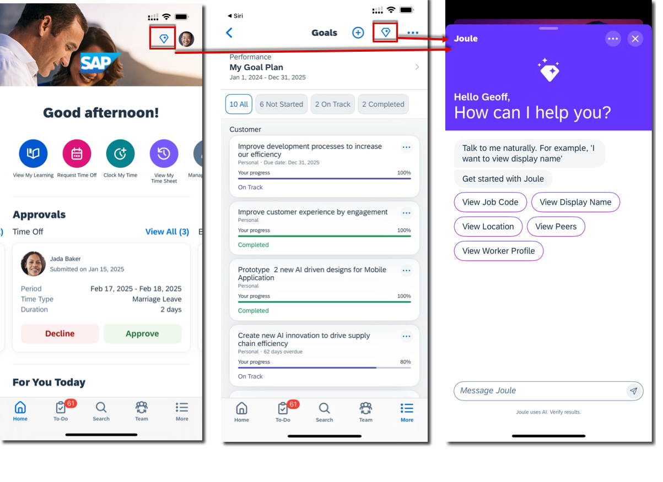
Sap joule digital agent enhancements
SAP Joule Digital Agent now supports 10 new languages: German, French, Spanish, Portuguese, Japanese, Korean, Chinese (Simplified), Vietnamese, Greek, and Polish. You can also ask questions in other languages, and Joule will respond in English.
SAP Joule is now integrated into the SAP SuccessFactors Mobile app for both iOS and Android.
SAP is continuously enhancing Joule, with new features added regularly. The latest updates were released in December 2024, January 2025, and March 2025. Most new features are automatically available, but some require setting up Employee Central Quick Actions first.
In Australia, the UK, and the USA, Joule can explain employee pay statements.

Slide 8
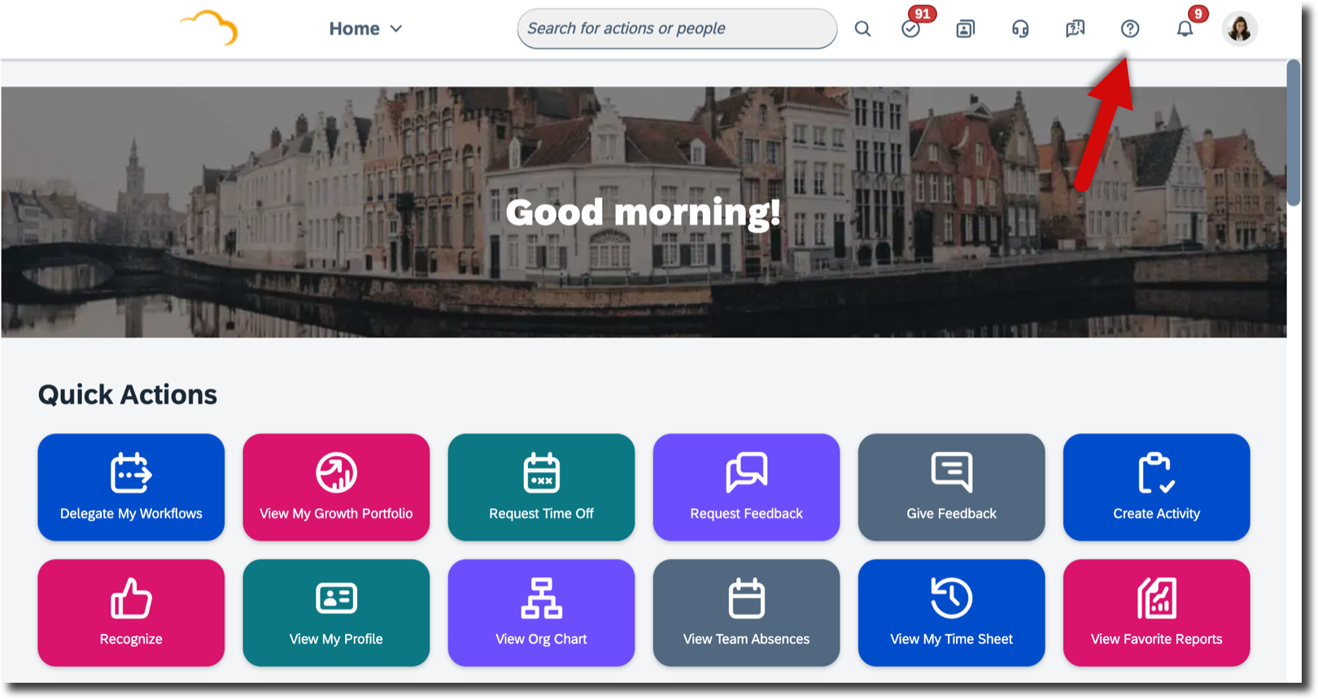
Free AND PREMIUM WALKME FUNCTIONALITY
SAP has simplified the process for enabling WalkMe functionality and has released free content that users can utilize. However, if you want to create your own content, you'll need a premium WalkMe license.
SAP has introduced 10 standard guided tours with the 1H 2025 release, available in US English. Out of these, 8 tours are designed for end users and 2 for administrators. SAP plans to deliver more guided tours in the future.

Slide 9
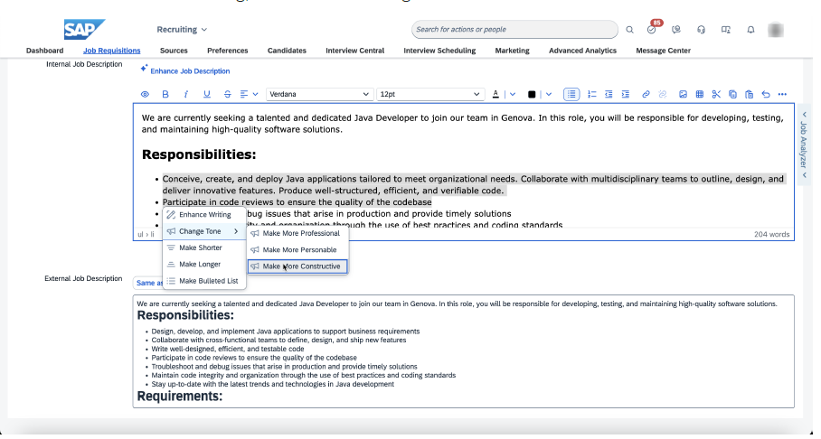
TEXT FIELD ENHANCEMENTS
SAP has expanded the AI writing assistant to more text fields across the SuccessFactors suite, building on the functionality introduced in the previous release. This assistant helps improve the content of text fields and now includes the ability to automatically translate values from US English into other enabled languages. Note that these features require AI Units.

Slide 10
Company field added to employee profile
SAP has added a new standard element to the employee profile to hold the company (legal entity) of an employee.
The string field value is HRIS synced from Employee Central to ensure data consistency and accuracy.

Slide 11
General display name automatically on
The General Display Name feature was introduced two years ago, allowing customers to configure employee names for consistent display across the SAP SuccessFactors HXM Suite.
Default Setting: If no specific name format is configured, the field is prepopulated with the full name (first, middle, and last name) based on the default locale.
Customization: You can define a name format for General Display Name either for a legal entity or within the People Profile. This can be a single format for the entire company or different formats for various legal entities, depending on your business needs.

Slide 12
Employee Central

Slide 13
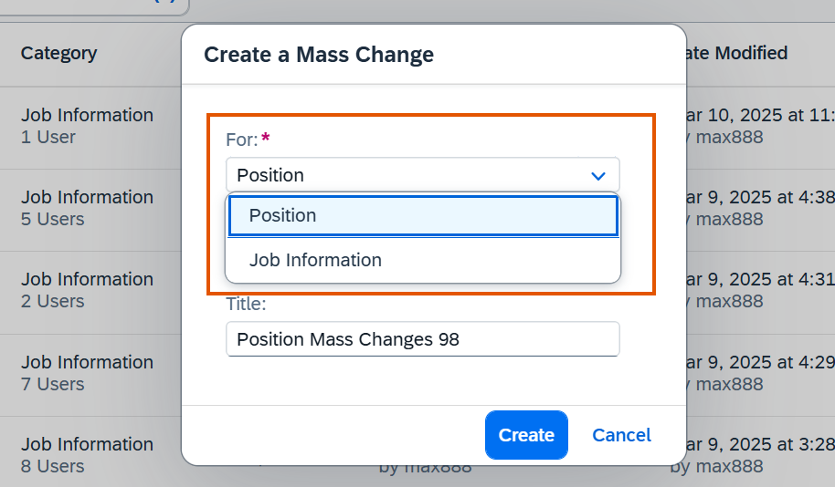
Mass data management supports job information
Job Information processing now allows for synchronous processing of up to 50 records in a single mass change request, improving data management efficiency. Previously, Mass Data Management only supported the Position data object.
Additionally, the Job History import has been renamed to Job Information import to avoid confusion when working with imported data.
SAP made this enhancement to enable customers to perform bulk changes to Job Information data for multiple employees simultaneously.

Slide 14
Add new employee to this position
You can now initiate a new hire process directly from a position in the Position Org Chart. This means that when you hire someone for a specific position, the position-related details will be automatically prefilled.
On the Position Org Chart, from the Actions menu of a position, select Add New Employee to This Position.
The action takes you to the Add New Employee UI, where you can complete the information needed for the hire. The following fields are prefilled with position information:
The Hire Date is filled with Today's date or the date defined using the calendar in the Position Org Chart.
The Position field
The Company field
These fields are Read–Only to ensure data consistency.

Slide 15
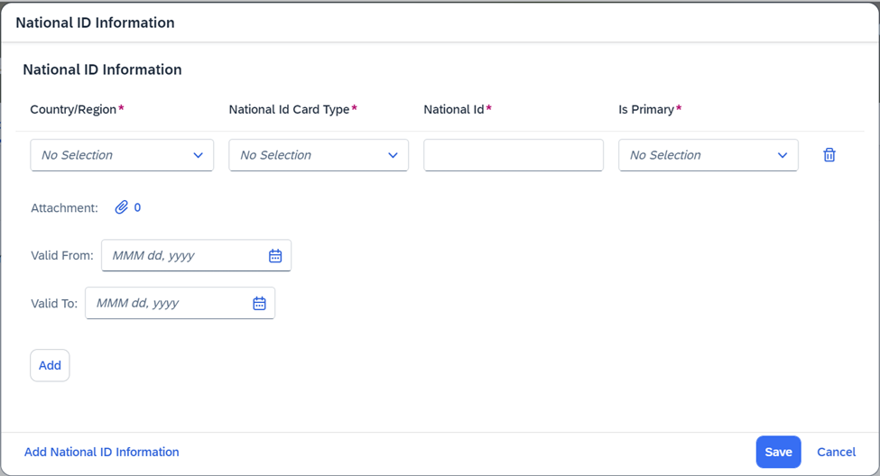
New national id information with validity period
To help track lifelong changes to your national ID information, SAP has added validity fields: Valid From and Valid To for each National ID record in National ID Information.
New validity fields (Valid From and Valid To) in National ID Information can now be added to the National ID portlet. This enhancement allows for additional configuration to set the multi-record relationship for specific countries or regions. You can define how multiple National ID records are validated, such as multiple records under one card type or sequential records across different card types. If no allowlist configuration is set for a specific national ID card type, multiple records related to that card type will not be allowed.
SAP made this enhancement so users can maintain multiple National ID records with different validity periods at the card type and country/region level.

Slide 16
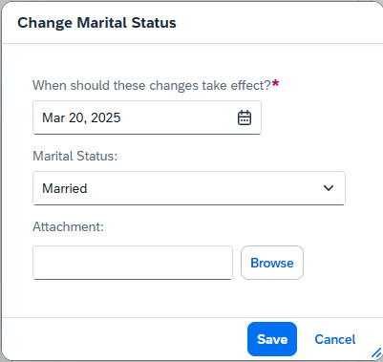
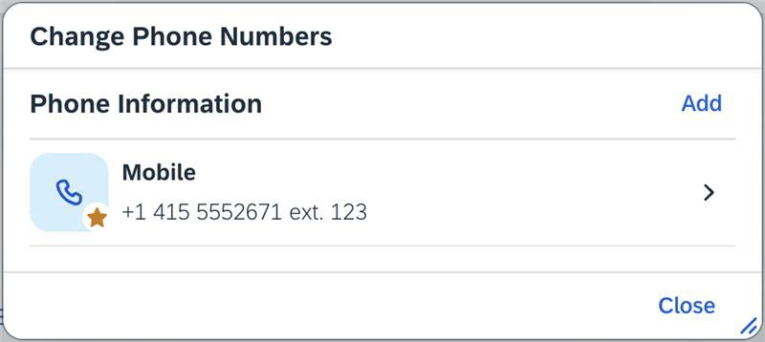
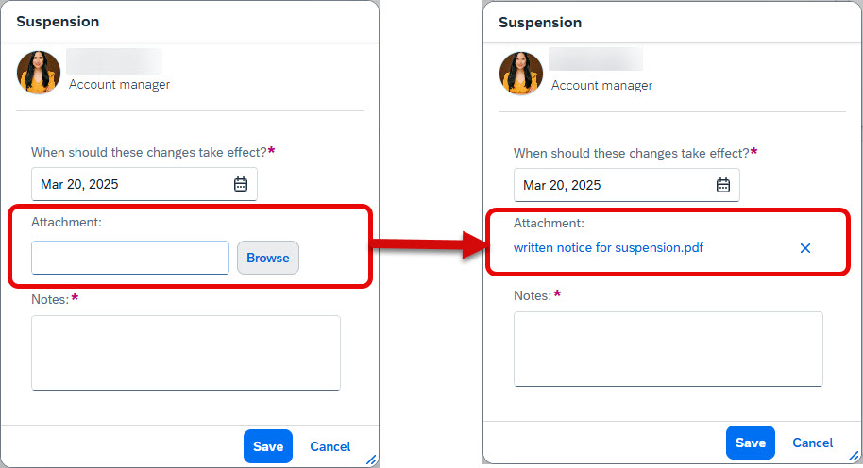

Enhancements to quick actions
For commonly used Employee Self-Service and Manager Self-Services, you can define Employee Central Quick Actions using templates tailored to your company's and country/region-specific requirements.
New features include:
Adding attachments to Employee Central Quick Actions.
New Quick Action for One-Time Payments.
Quick Actions for Phone Numbers.
onView rules are now supported for Employee Central Quick Actions.
For specific use cases, you can now add an attachment to Employee Central Quick Actions.

Slide 17
Deprecation of rehire inactive employees
SAP is deprecating the Rehire Inactive Employees page. Instead, you can use the Duplicate Check dialog, accessible from the Manage Pending Hires tool or the Add New Employee page. This change simplifies the rehiring process for inactive employees by providing Duplicate Check as the sole, comprehensive UI entry point.
Advantages of Duplicate Check over Rehire Inactive Employees:
National ID data is checked when searching for inactive employee matches, reducing the number of matches.
Matched employees display information about their current and past employments, including legal entities and contingent employment indicators.
You can rehire an employee whose termination date is in the future, as long as the rehire date is after the termination date. Duplicate Check will display options to accept the match or rehire with new employment.
If you currently use Rehire Inactive Employees for rehiring, it's recommended to transition to Duplicate Check and familiarize your HR administrators and managers with its process. Additionally, update your existing workflows, as Rehire Inactive Employees will not be available after May 16, 2026.

